Slide 1
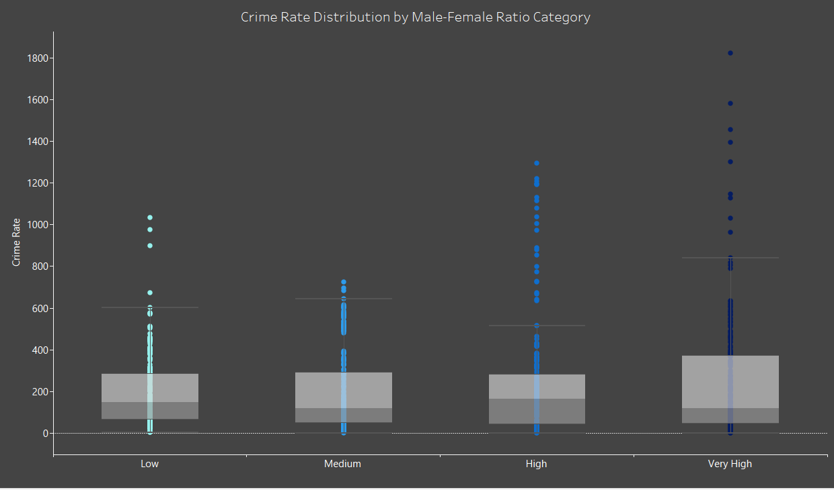






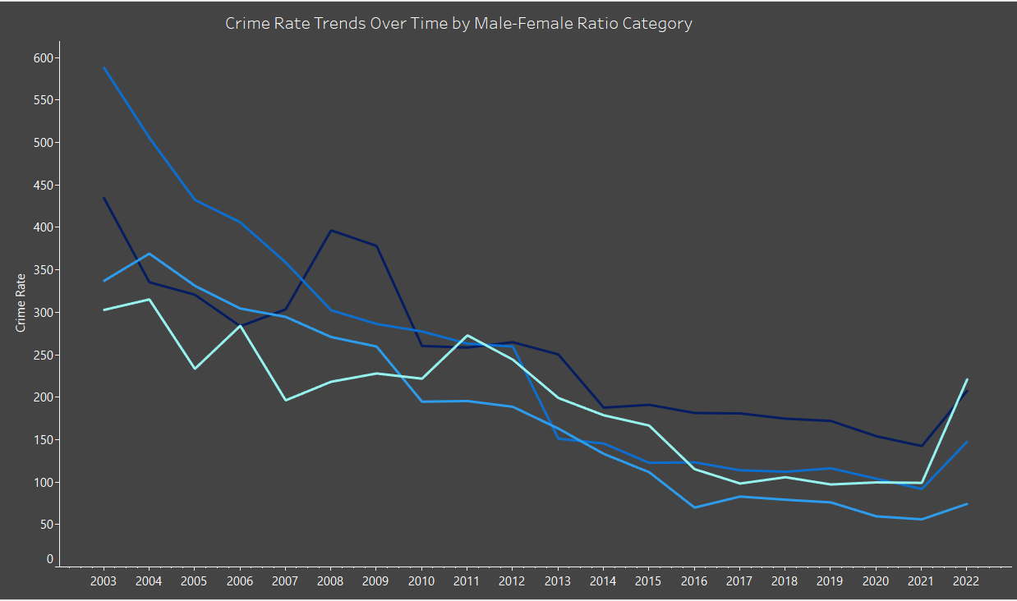

HOW MALE-TO-FEMALE RATIOS AFFECT CRIME RATE
Highlights
Jassem Shehadeh
The overall correlation is weak (0.089), but the 45-64 age group shows a moderate correlation with both violent and economic crimes.
In presumably unstable environments, higher male-to-female ratios were associated with higher average crime rates across years and countries.
Unexpected moderate correlation between public education spending (GDP %) and crime rates, possibly due to inefficient resource management or better crime reporting, while population density shows no correlation with crime rates at the country level.
Background
Analytical Approach
Could gender ratios influence crime rates?
This study uses global data to explore the relationship between male-to-female ratios and crime trends.
By analyzing age-specific crime correlations, aims to uncover insights that can help shape better policies for safer societies.
Data Processing & Transformation:
Cleaned and reshaped datasets to ensure consistency across years and countries.
Merged demographic, crime, and economic data for cross-analysis.
Statistical Analysis:
Calculated correlation coefficients (Pearson) to assess relationships between gender ratios and crime rates.
Conducted ANOVA and Tukey’s HSD tests to compare crime rate variations across different gender ratio groups.
Data
When the male-to-female ratio is higher, the average crime rate per 100,000 people is higher across years and countries with some cases showing extremely high crime rates.
When we analyze the correlation between the male-to-female ratio by age group and crime type, a clear trend stands out, the 45 to 64 age group shows a moderate positive correlation, which is consistent across both crime categories.
This analysis utilizes five key datasets each providing crucial insights into demographic factors influencing crime rates.
The datasets were cleaned, reshaped, and merged, allowing for an exploration of how gender ratios impact crime rates and whether education spending and population density play a significant role in crime trends.
Crime Rate Distribution by Male-Female Ratio Category
Male-to-Female Ratio & Crime Rates Correlation
1800-
Violent Crimes
Economic Crimes
Age 0-14
-0.16
-0.08
Population by Age & Sex
Violent Crimes
Economic Crimes
Public Education Spending
Population Density
1000-
Age 15-24
-0.07
0.04
Age 25-44
0.04
0.18
400-
Age 45-64
0.25
0.26
0-
Age 65+
0.21
-0.07
51 distinct country
600-
Crime Rate Trends Over Time by Male-Female Ratio Category by Year
A high male-to-female ratio might not directly affect crime rates, however, this ratio could create an environment of instability or chaos.
Countries with a male-to-female ratio equal to 1 and higher should carefully monitor and address social, economic, and law changes that may amplify the impact of this demographic balance on crime rates.
Years from 2003 to 2022
Male-to-Female ratio by 5 age groups
(0-14) (15-24) (25-44) (45-64) (65+)
Crime rate per 100,000 people by 2 categories
(Violent crimes) (Economic crimes)
300-
Country's public education spending as a percentage of its total GDP
Density per square kilometer
0-
2003
2009
2016
2021

